Slide 1

MexE 406
Robotics 1
Engr. Mikko A. De Torres
Mechatronics Engineer
Department of Electronics Engineering
Batangas State University || College of Engineering

Slide 2
“Mechanical Manipulators”
Engr. Mikko A. De Torres
Mechatronics Engineer
Department of Electronics Engineering
Batangas State University || College of Engineering

Slide 3
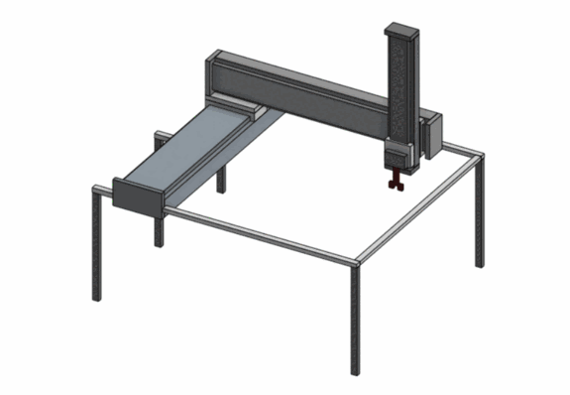
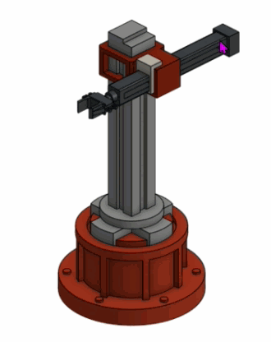
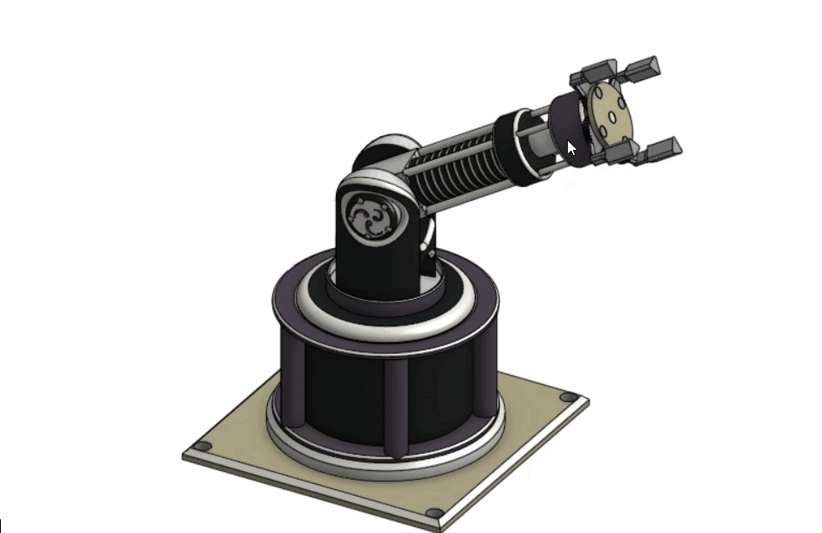
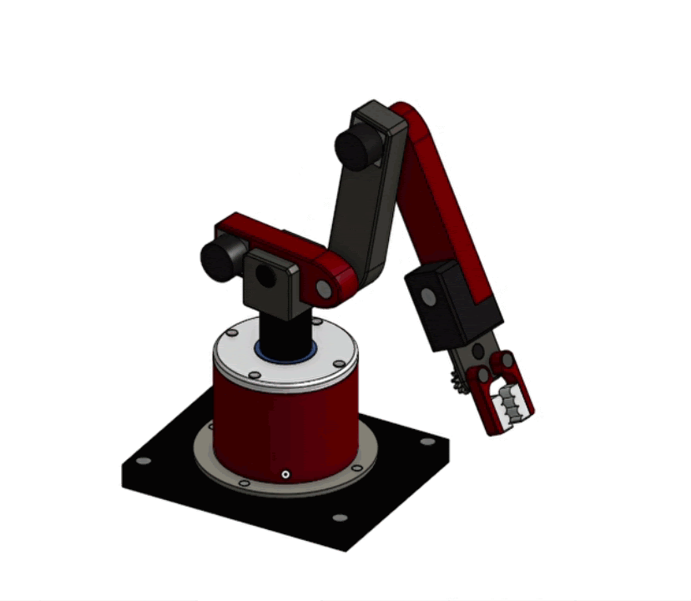
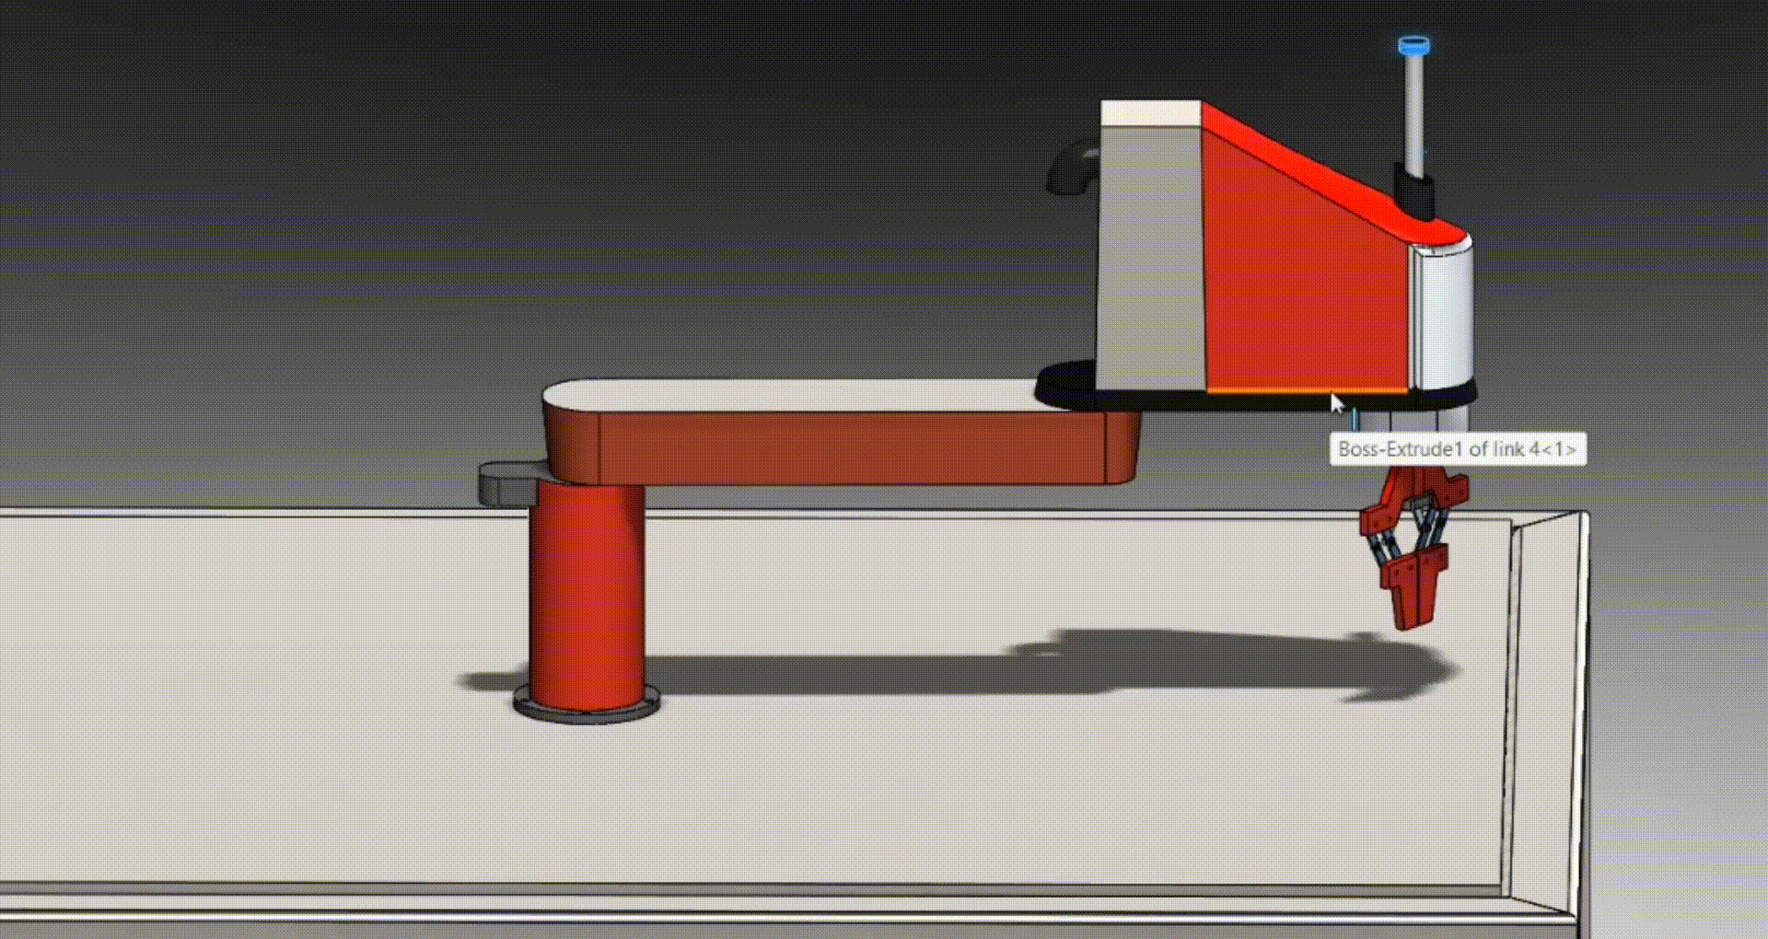
Industrial Robot Arm = Mechanical Manipulator
We will mainly deal with industrial robots which are both almost look like an arm and does not look like an arm, but functions like an arm.
Notes:
CAD Drawings from:
BlockD_3203_21-22_Cartesian
BlockE_3203_21-22_Cylindrical
BlockE_3203_21-22_Spherical
BlockD_3203_21-22_Articulated
BlockD_3203_21-22_SCARA

Slide 4
Industrial Robot Arm
a type of robot consisting of parts linked together in the same way as those of a human arm, mounted on a stand
=
Mechanical Manipulator
a type of robot consisting of parts linked together in the same way as those of a human arm, mounted on a stand
We will mainly deal with industrial robots which are both almost look like an arm and does not look like an arm, but functions like an arm.
Notes:
Industrial Robot Arm from www.designrobotics.net

Slide 5
“Anatomy”
Engr. Mikko A. De Torres
Mechatronics Engineer
Department of Electronics Engineering
Batangas State University || College of Engineering

Slide 6
Mechanical Manipulator Anatomy
This deals with the study of different joints and links and other aspects of the manipulator's physical construction.

Slide 7
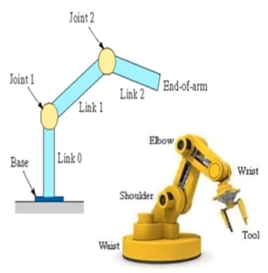
Mechanical Manipulator Anatomy
Base – support the mechanical manipulator
Link – A rigid member that connects the joints. It can be an input link and output link.
Joint - Integrates 2 or more links to provide controlled relative movement by input and output link.
End effector – It is any device at the end of the mechanical manipulator which is shaped like a hand or as a special tool depending upon the application.

Slide 8
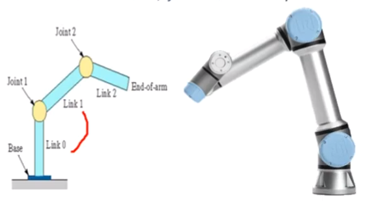
Mechanical Manipulator Anatomy
Depending on the relative motion between the links, joints are mainly classified into:
Prismatic Linear Joint (L-joint)
Prismatic Orthogonal Joint (O-joint)
Rotational or Revolute Joint (R-joint)
Twisting Joint (T-joint)
Cylindrical Joint (C-joint)
Spherical Joint (S’-joint)
Hooke Joint or Universal Joint (U-joint)

Slide 9

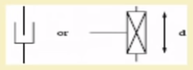
Mechanical Manipulator Anatomy
1. Prismatic Linear Joint (L-joint)
- This type of joint allows a translational motion between the input and output links with the axes of the links parallel to each other.

Slide 10
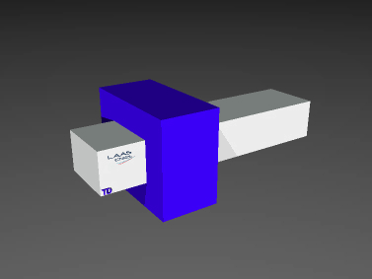
Mechanical Manipulator Anatomy
2. Prismatic Orthogonal Joint (O-joint)
- This type of joint allows a translational motion between the input and output links with the axes of the links perpendicular to each other.

Slide 11
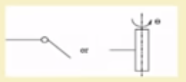
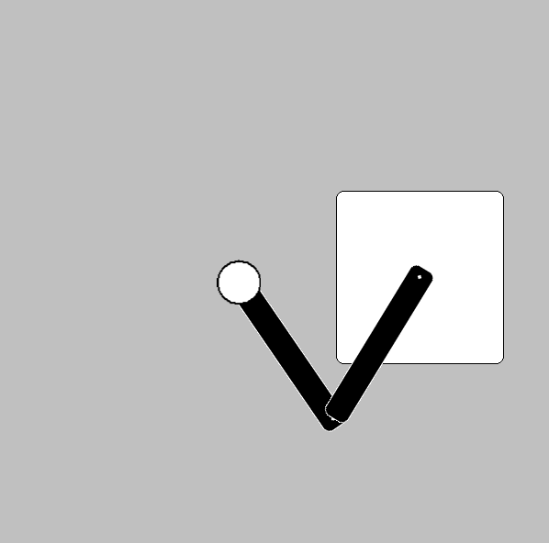
Mechanical Manipulator Anatomy
3. Rotational or Revolute Joint (R-joint)
- This type of joint allows a rotary relative motion between the input and output links with the axis of rotation perpendicular to the input link.

Slide 12

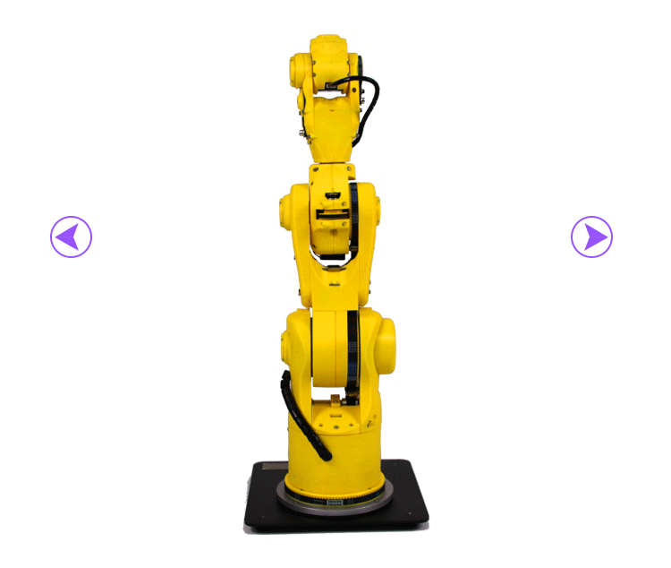
Mechanical Manipulator Anatomy
4. Twisting Joint (T-joint)
- This type of joint allows rotary motion with the axis of rotation parallel to the axes of input and output link.

Slide 13
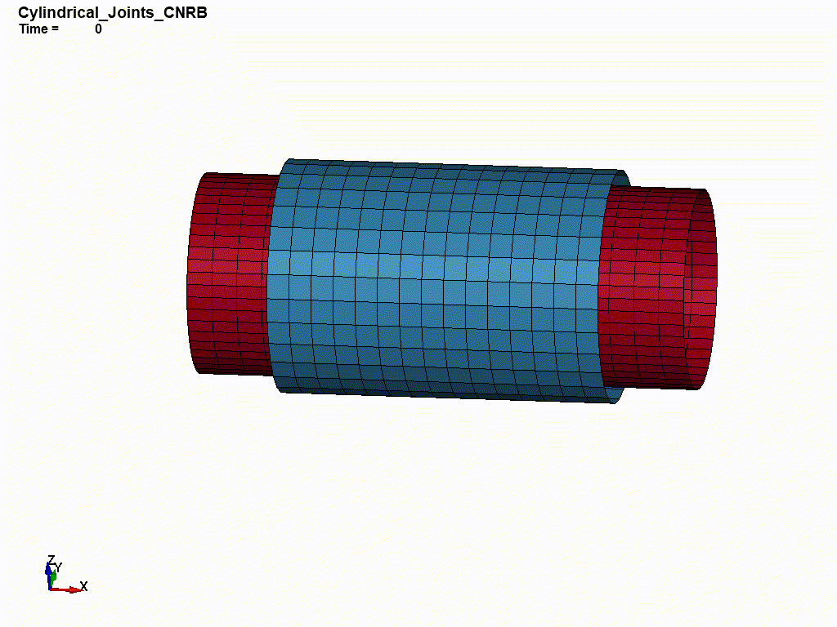
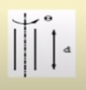
Mechanical Manipulator Anatomy
5. Cylindrical Joint (C-joint)
- This type of joint provide single-axis sliding function as well as a single axis rotation, providing a way for two rigid bodies to translate and rotate freely.

Slide 14
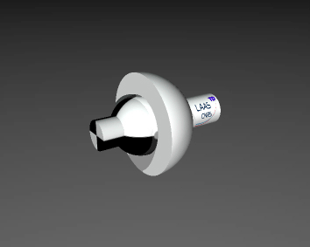

Mechanical Manipulator Anatomy
6. Spherical Joint (S’-joint)
- also known as a ball-and-socket joint, allows three relative rotations between the two connected segments and is frequently used to model the hip and shoulder joints.

Slide 15

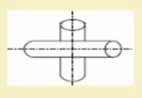
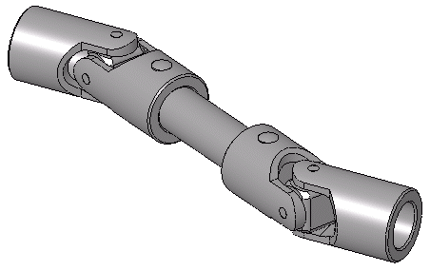
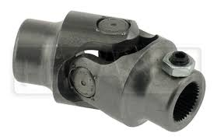
Mechanical Manipulator Anatomy
7. Hooke Joint or Universal Joint (U-joint)
- is a joint or coupling connecting rigid rods whose axes are inclined to each other, and is commonly used in shafts that transmit rotary motion.

Slide 16
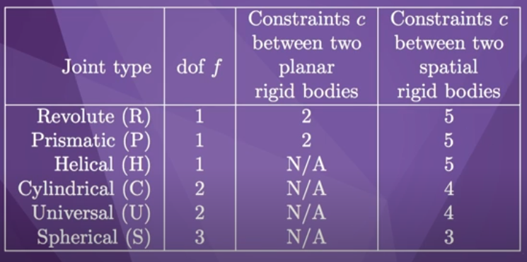
Mechanical Manipulator Anatomy

Slide 17
Knowledge Check: Identify the classification of Joints
Prismatic Orthogonal Joint (O-joint)

Slide 18
Knowledge Check: Identify the classification of Joints
Rotational or Revolute Joint (R-joint)

Slide 19
Knowledge Check: Identify the classification of Joints
Prismatic Linear Joint (L-joint)

Slide 20
Knowledge Check: Identify the classification of Joints
Twisting Joint (T-joint)

Slide 21
Knowledge Check: Identify the classification of Joints
Hooke Joint or Universal Joint (U-joint)

Slide 22
Knowledge Check: Identify the classification of Joints
Cylindrical Joint (C-joint)

Slide 23
Knowledge Check: Identify the classification of Joints
Spherical Joint (S’-joint)

Slide 24
Self Review
Any device at the end of the mechanical manipulator is a(n) __________.
Twisting joint allows rotary motion with the axis of rotation _________ to the axes of input and output link.
A(n) ______ is a rigid member that connects the joints.
Revolute joint allows a rotary relative motion between the input and output links with the axis of rotation _________ to the input link.
A(n) ___________ frequently used to model the hip and shoulder joints.
base joints parallel cylindrical joint
rotary end effector manipulator
link anatomy matrix orthogonal
spherical joint prismatic cylinder
ball pivot mechanics perpendicular
tool universal joint mechanical

Slide 25
Self Review
Any device at the end of the mechanical manipulator is a(n) end effector.
Twisting joint allows rotary motion with the axis of rotation parallel to the axes of input and output link.
A(n) link is a rigid member that connects the joints.
Revolute joint allows a rotary relative motion between the input and output links with the axis of rotation perpendicular to the input link.
A(n) spherical joint frequently used to model the hip and shoulder joints.
base joints parallel cylindrical joint
rotary end effector manipulator
link anatomy matrix orthogonal
spherical joint prismatic cylinder
ball pivot mechanics perpendicular
tool universal joint mechanical

Slide 26
Thank You!

